Slide 1

Student Alcohol Consumption: “Are you SURE aiming a higher education?”
classification
December 2nd, 2022
Written by Nadia Oktiarsy (Rmt batch-016)

Slide 2
An overview
Do students have an academic problem because of alcohol drinking habits? Is it recommended to continue their study?
Continuing
Suggested to continue the education
Classification Model
All students with alcohol consumption regular habits
Not continuing
Suggested to repeat the class
Target:
Education institutions and health organizations
Notes:
https://huggingface.co/spaces/nadiaoktiarsy/deployment

Slide 3
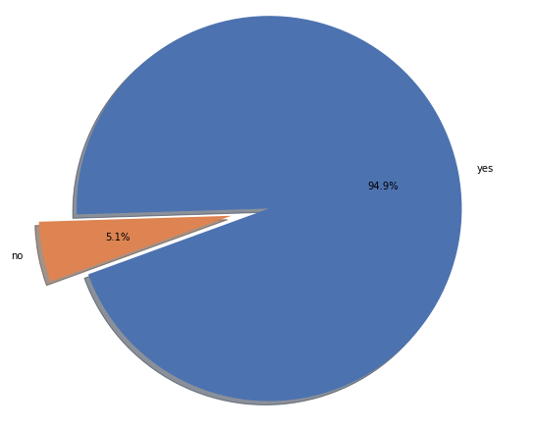
Actual data
Students still want to continue their study: The distribution of students who want to continue their study is imbalanced.
Pie chart Continuing vs Not Continuing Study
Disadvantages
The model will be biased towards the majority class only. Imbalance data handling is needed.

Slide 4
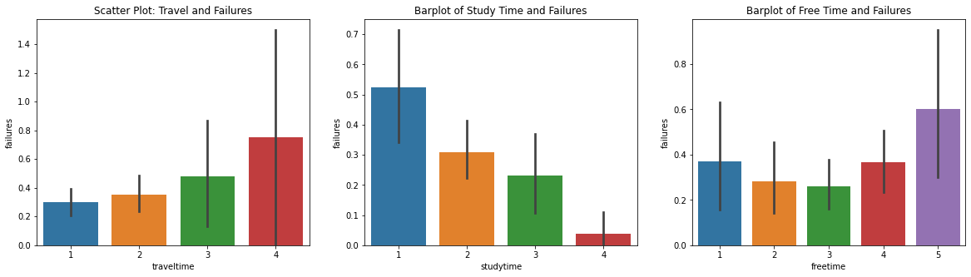
Features selection
Students performance: Study Time and Free Time are apparently influencing their success of continuing their education.

Slide 5
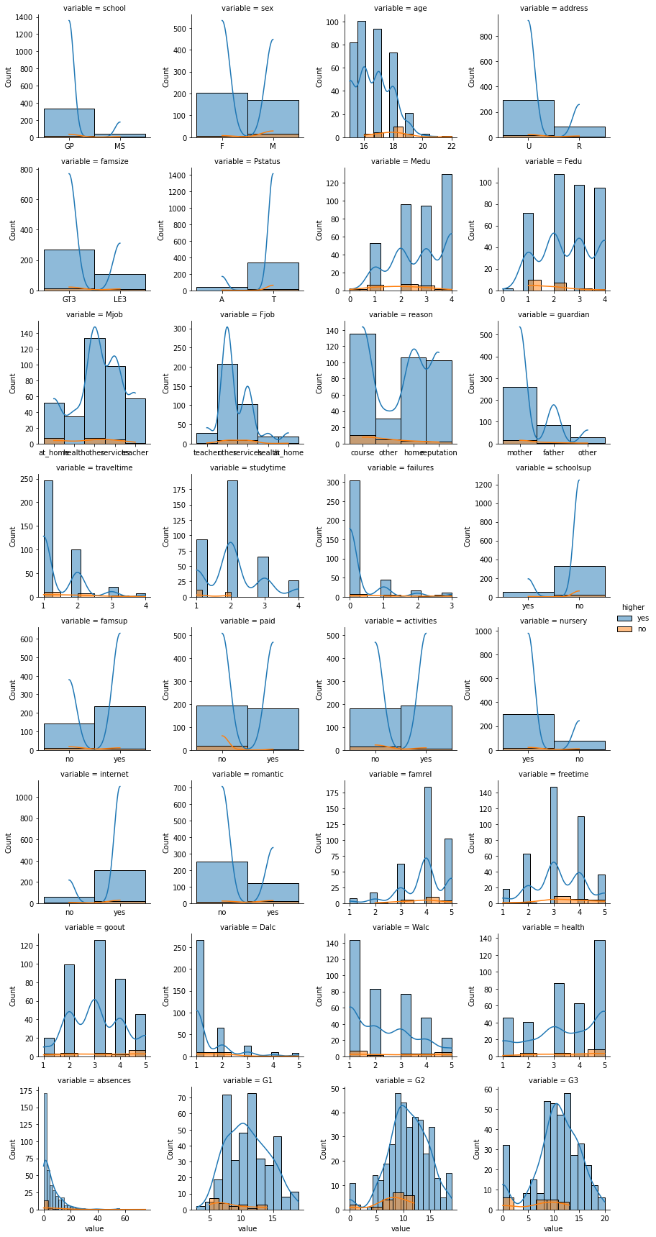
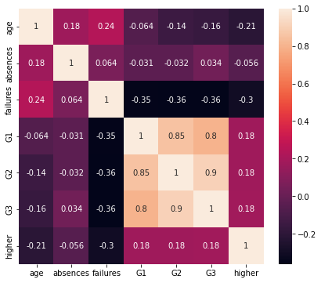
Features selection
Students performance: Grades (0-20) can influence student’s decision to continue a higher education or not.

Slide 6
Model selection
Picking the best techniques with the better score based on mean precision and standard deviation of cross-validation: Logistic Regression
Cross-validation (k=5), Default Parameters, score: Precision
Algorithms | Precision | Standard Deviation
Logistic regression | 0.91 | 0.03
SVM | 0.98 | 0.01
Decision Tree | 0.94 | 0.04
Random Forest | 0.98 | 0.01
Further about Hyperparameter tuning for Logistic Regression:
Best Hyperparameters
Default Parameters
vs
{'logreg__max_iter’ : 25, 'logreg__penalty’ : 'none', 'logreg__solver’ : 'lbfgs'}

Slide 7
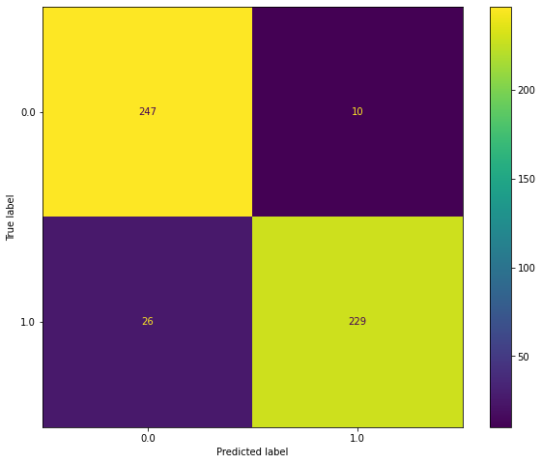
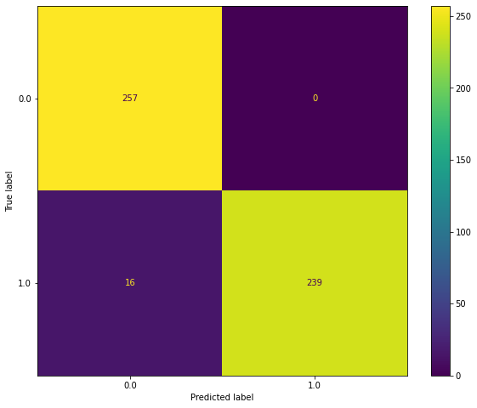
Logistic regression
Default Parameters
Hyperparameter Tuned
Precision | Default | Tuned
Train Set | 0.93 | 0.97
Test Set | 0.93 | 0.96
An increase F1-score and accuracy from Logistic Regression is included as good model rather than the other models. However, we should be careful for the hyperparameter tuned model, which can lead an overfitting when we simulate for the data inference.

Slide 8
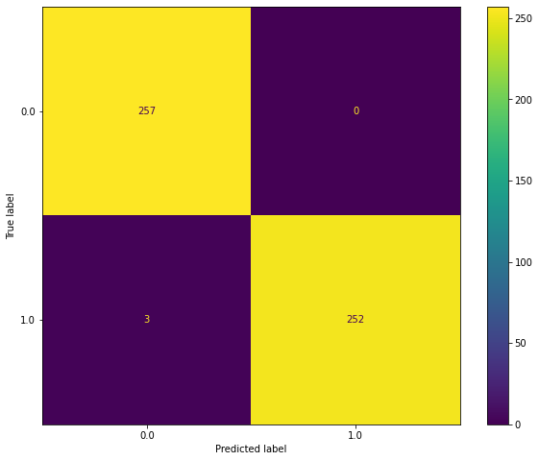
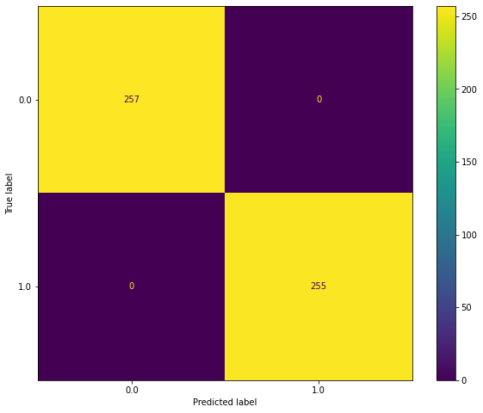
Svm
Default Parameters
Hyperparameter Tuned
Precision | Default | Tuned
Train Set | 0.99 | 1.0
Test Set | 0.99 | 1.0
SVM is too strong for this dataset, which makes the F1-score is 100%. So, it is basically overfit for the small data, and SVM is better to be used for a bigger dataset.

Slide 9

Decision tree
Default Parameters
Hyperparameter Tuned
Precision | Default | Tuned
Train Set | 1.0 | 0.99
Test Set | 0.97 | 0.98
Decision Tree is having a decrease compare to the other models, although it is just slightly decreasing. Decision tree will not be chosen as the main model later, although it has a potential, but the result for F1-score and accuracy could be overfit. This can cause a bias as well.

Slide 10
Random forest
Default Parameters
Hyperparameter Tuned
Precision | Default | Tuned
Train Set | 1.0 | 1.0
Test Set | 1.0 | 1.0
There is no change between default parameter and hyperparameter tuned model. No further analysis for this, however, we can take notes that Ensemble Learning such as Random Forest Classifier should be used for a bigger dataset rather than relatively small dataset like this.

Slide 11
Logistic regression
Default Parameters
Suggestion:
Educational Institution and Health Organization
for alcohol consumption should not be allowed for student, or underage of young adults (around 20 years old)
1. The legalization
2. Consistent meeting and discussion between parents and education institution
Struggling to maintain their grades because of alcohol habits and other backgrounds. Parents and education institution should make a consistent meeting to maintain student for not consuming alcohol excessively.
We can conclude that the model--using Logistic Regression default parameter--predicts students who should continue their study or not, and apparently the prediction suggests that more students with alcohol habits are included as "failing to continue their study", which is showed by True Positive (0-0) with number of predicted students 247. Meanwhile for its opposite, which is True Negative (1-1), there are 229 students predicted to "passing to continue their study".

